Slide 1
IKitchen
How hungry are you ?
An application developed by
Flavian Bisconti
Nathan Pire
Quentin Zaretti

Slide 2

What is IKitchen ?
Web application
Cooking Website
Online booking platform
Friendly sharing forum

Slide 3
Who was it designed by ? In what context ?
Who ?
Computer science students
Aspiring anylist-programmers
What context ?
Multidisciplinary group project
Second year’s June finals

Slide 4
What are the steps that were followed ?
Analysis
UML diagram design
Class structure and association
Labour division
Meeting scheduling
Idea development
Analysis file writing
Programming
GitHub creation
Class implementation
Asp.Net use
Entity Framework

Slide 5
The UML diagrams
Three axes : functional, static and dynamic

Slide 6
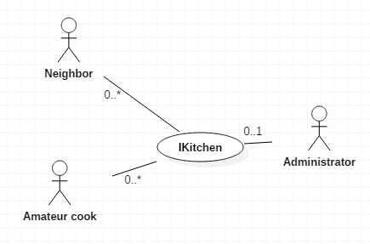
The Functional Axis
Static context diagram

Slide 7
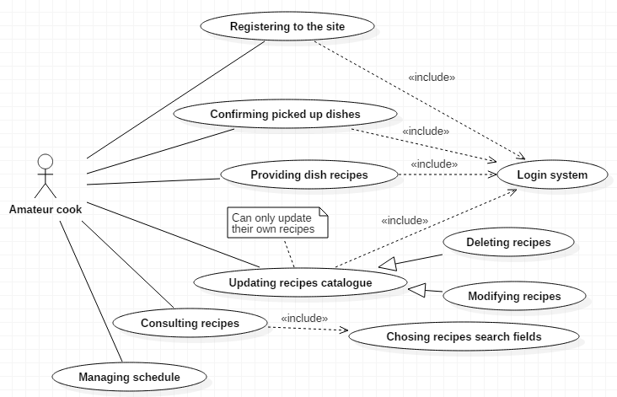
The Functional Axis
Cook use case diagram

Slide 8
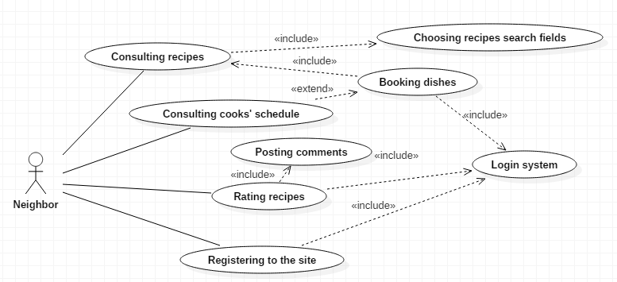
The Functional Axis
Neighbor use case diagram

Slide 9
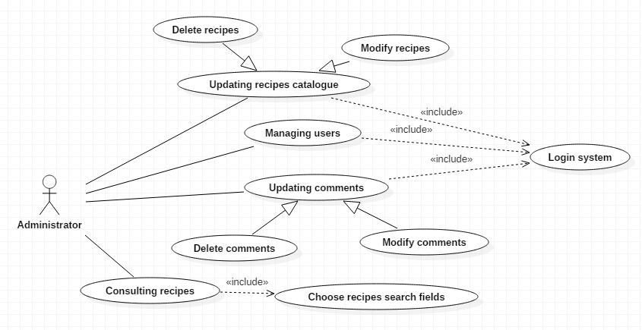
The Functional Axis
Admin use case diagram

Slide 10
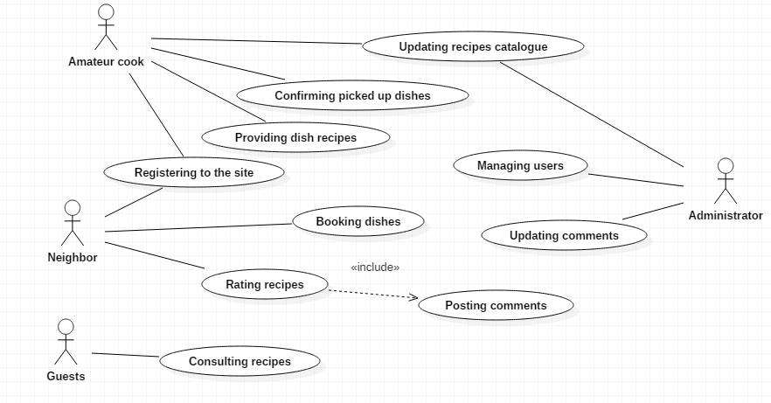
The Functional Axis
Summarized use case diagram

Slide 11
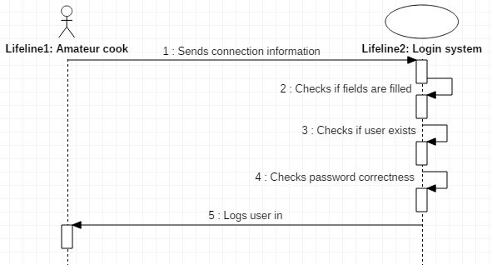
The Functional Axis
Login sequence diagram
Nominal
Alternative
Exception

Slide 12
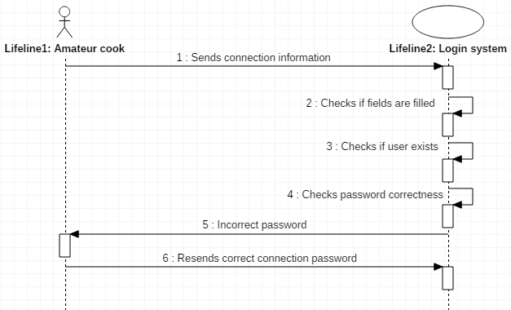
The Functional Axe
Login sequence diagram
Nominal
Alternative
Exception

Slide 13
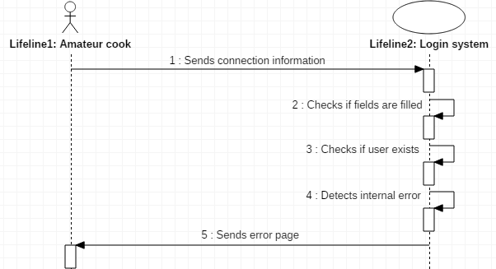
The Functional Axe
Login sequence diagram
Nominal
Alternative
Exception

Slide 14
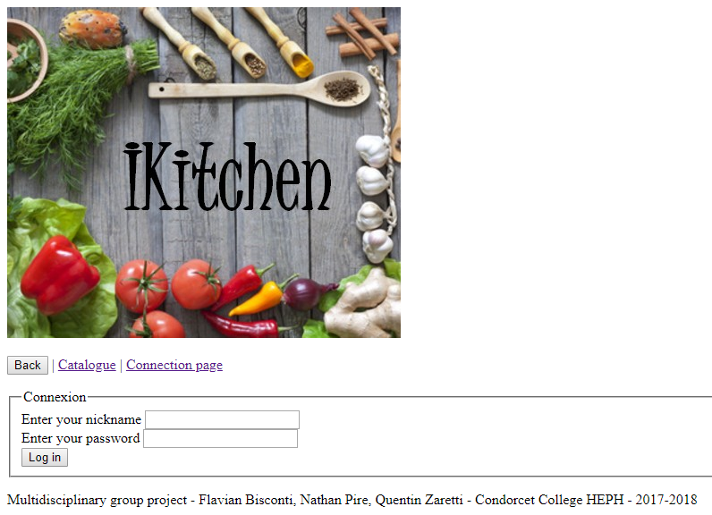
The Static Axis
Four iterations
Registering
Booking/Catalogue
Uploading
Administration
Establishment of partial class diagrams

Slide 15
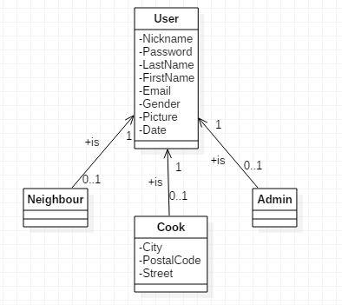
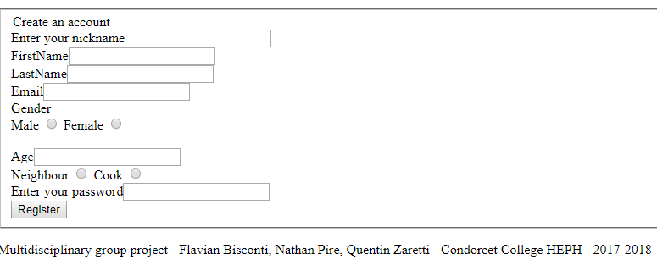
The Static Axis
User’s group automatically determined at the connection
Registering and administration

Slide 16
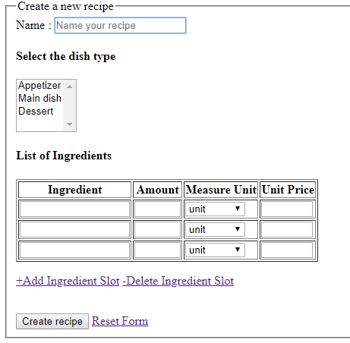
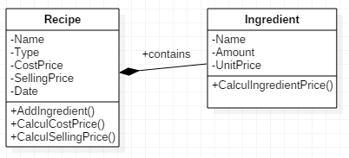
The Static Axis
Recipe uploading

Slide 17
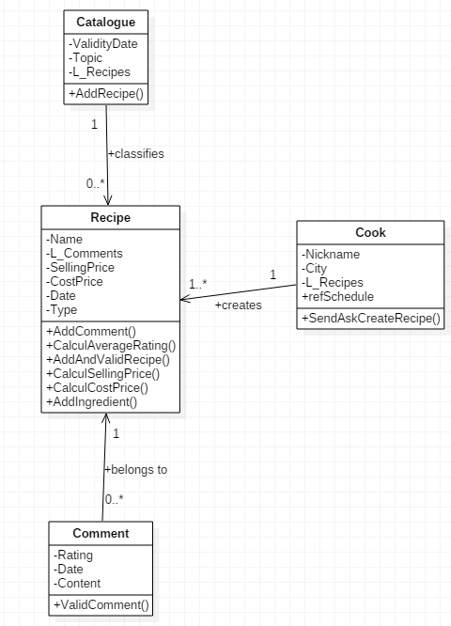
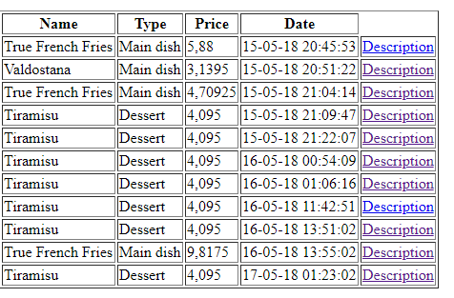
The Static Axis
Catalogue and booking

Slide 18
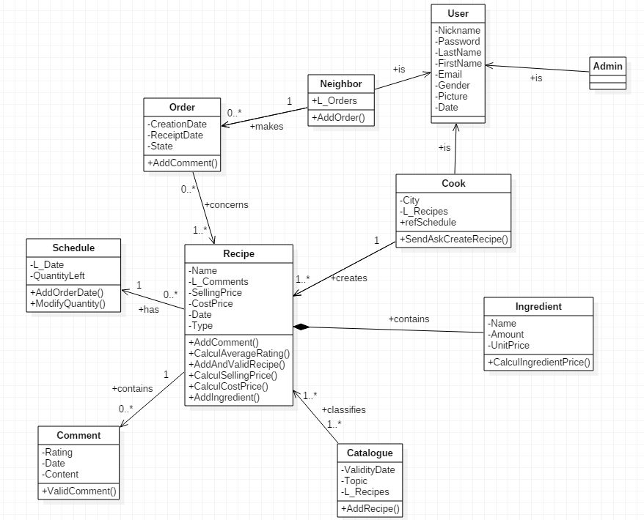
The Static Axis
Class diagram

Slide 19
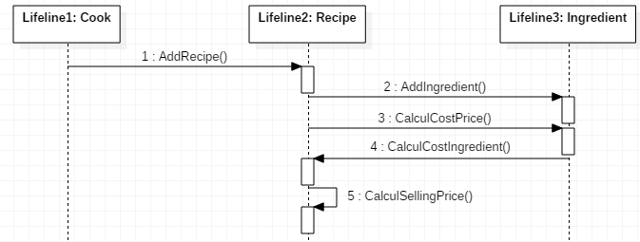
The Dynamic Axis
Providing dish recipe : analytical sequence diagram

Slide 20
Conclusions
What are our thoughts about this project ?

Slide 21
Conclusions
Flavian Bisconti
Quentin Zaretti
Nathan Pire
Devised his first computer application
Took pleasure in programming
Rewarded by the teamwork
Used and improved skills from secondary school
Learned how to focus on one issue at a time
First real teamwork
Learned that teamworking is better
Learned how to adapt foreign code
Like to work in a team
Learn new things about Entity Framework
Learn how to adapt you at a deadline
It’s difficult to work in group sometimes

Slide 22
The End
We are now very hungry.

